Slide 1
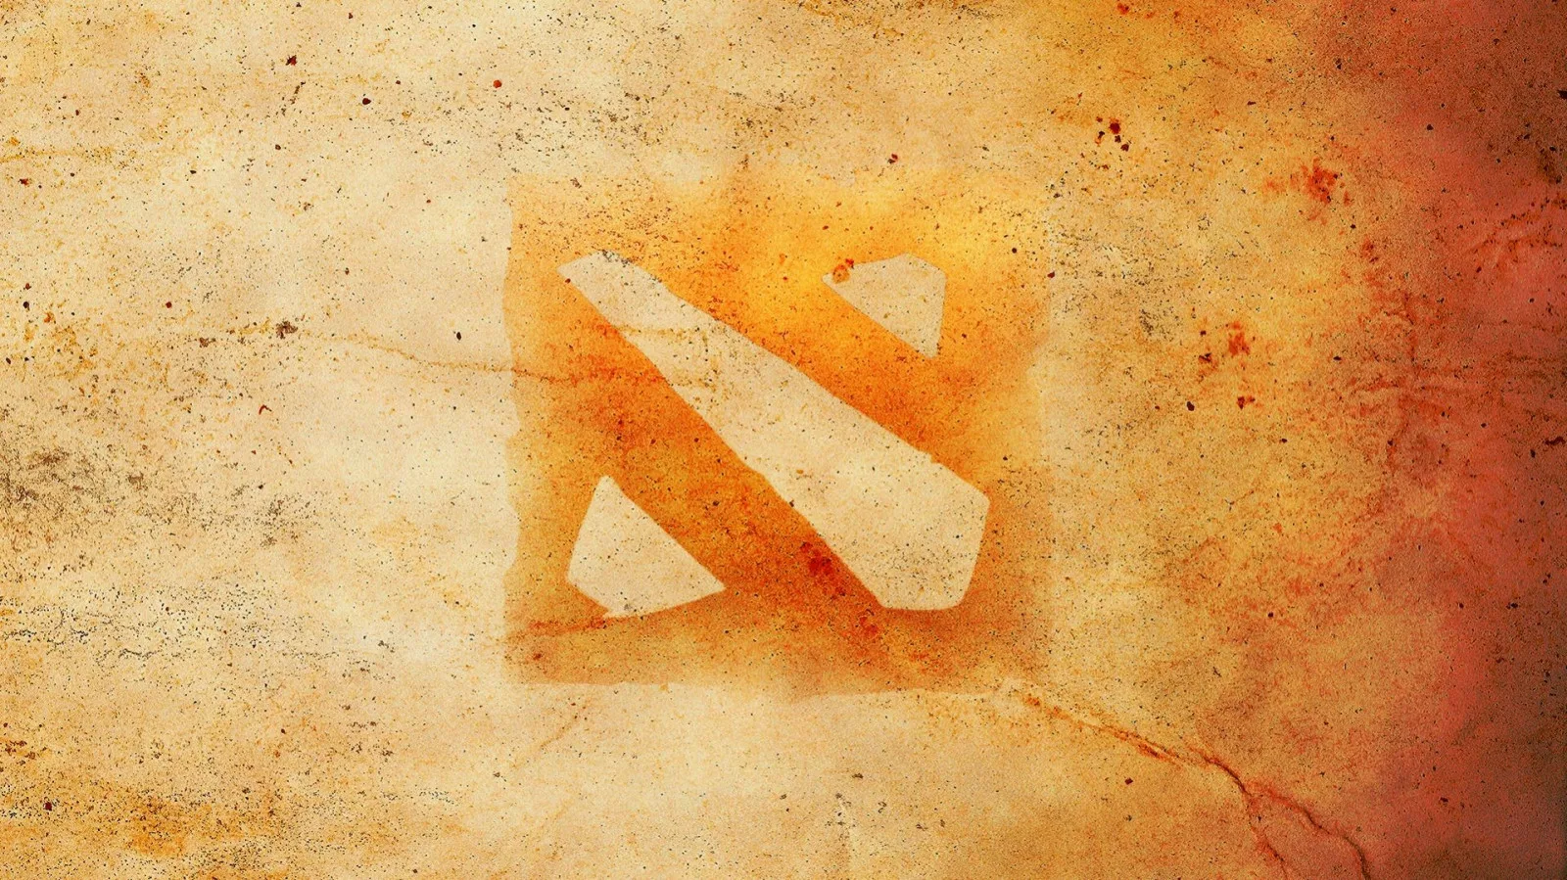
FISSURE Universe: Episode 5
(Group Stage)
Parivision
Фраги <42,5: 46%
Фраги >42,5 & <54,5: 31%
Фраги >54,5: 23%
MAP: 1 (ID: 8313181748)
Time: 36:57
Score: 40
Team Yandex
Date: 30.05.2025
MAP: 1 (ID: 8313181748)
Time: 36:57
Score: 40

Slide 2
Log Kills:
02:53 (Dire - Goodwin team )-1 Ursa kills Sniper
03:05 (Dire - Goodwin team )-2 Ursa kills Pangolier
03:47 (Dire - Goodwin team )-3 Mars kills Jakiro
06:08 (Radiant - VooDooSh Team)-1 Phoenix kills Ember Spirit
06:16 (Dire - Goodwin team )-4 Shadow Shaman kills Jakiro
06:23 (Radiant - VooDooSh Team)-2 Phoenix kills Shadow Shaman
08:33 (Radiant - VooDooSh Team)-3 Sniper kills Shadow Shaman
09:01 (Radiant - VooDooSh Team)-4 Jakiro kills Disruptor
09:47 5=> (Dire - Goodwin team )-5 Disruptor kills Phantom Assassin
10:36 (Radiant - VooDooSh Team)-5 Phantom Assassin kills Mars
11:20 (Radiant - VooDooSh Team)-6 Sniper kills Shadow Shaman
11:28 (Dire - Goodwin team )-6 Disruptor kills Phantom Assassin
11:30 (Dire - Goodwin team )-7 Ursa kills Jakiro
11:42 (Dire - Goodwin team )-8 Mars kills Sniper
12:32 (Dire - Goodwin team )-9 Ember Spirit kills Phoenix
12:41 10=> (Dire - Goodwin team )-10 Ursa kills Phantom Assassin
13:54 (Radiant - VooDooSh Team)-7 Phantom Assassin kills Shadow Shaman
14:34 (Dire - Goodwin team )-11 Mars kills Phoenix
14:34 (Dire - Goodwin team )-12 Ember Spirit kills Phantom Assassin
14:38 (Dire - Goodwin team )-13 Mars kills Jakiro
14:55 (Radiant - VooDooSh Team)-8 Sniper kills Ember Spirit
14:57 (Radiant - VooDooSh Team)-9 Pangolier kills Shadow Shaman
16:20 (Dire - Goodwin team )-14 Mars kills Jakiro
16:22 15=> (Dire - Goodwin team )-15 Ursa kills Phoenix
16:22 (Dire - Goodwin team )-16 Shadow Shaman kills Pangolier
19:13 (Dire - Goodwin team )-17 Mars kills Pangolier
19:34 (Dire - Goodwin team )-18 Ursa kills Jakiro
20:04 (Dire - Goodwin team )-19 Mars kills Sniper
20:10 20=> (Dire - Goodwin team )-20 Ursa kills Phoenix
20:39 (Dire - Goodwin team )-21 Ursa kills Phantom Assassin
21:13 (Radiant - VooDooSh Team)-10 Phoenix kills Ember Spirit
21:58 (Radiant - VooDooSh Team)-11 Sniper kills Mars
21:58 (Radiant - VooDooSh Team)-12 Phantom Assassin kills Shadow Shaman
22:04 (Dire - Goodwin team )-22 Ursa kills Pangolier
22:19 (Dire - Goodwin team )-23 Ember Spirit kills Sniper
22:30 (Dire - Goodwin team )-24 Ursa kills Phantom Assassin
22:35 (Dire - Goodwin team )-25 Ember Spirit kills Phoenix
23:59 (Dire - Goodwin team )-26 Ursa kills Sniper
24:08 (Dire - Goodwin team )-27 Ursa kills Phantom Assassin
24:13 (Dire - Goodwin team )-28 Mars kills Jakiro
24:23 (Dire - Goodwin team )-29 Disruptor kills Phoenix
24:57 (Dire - Goodwin team )-30 Mars kills Sniper
27:11 (Radiant - VooDooSh Team)-13 Phantom Assassin kills Disruptor
27:18 (Radiant - VooDooSh Team)-14 Phoenix kills Shadow Shaman
27:19 (Dire - Goodwin team )-31 Mars kills Phantom Assassin
27:28 (Dire - Goodwin team )-32 Ursa kills Phoenix
27:32 (Dire - Goodwin team )-33 Ursa kills Pangolier
27:41 (Dire - Goodwin team )-34 Ursa kills Sniper
27:53 (Dire - Goodwin team )-35 Ursa kills Jakiro
28:02 (Dire - Goodwin team )-36 Ursa kills Phoenix
28:05 (Dire - Goodwin team )-37 Ursa kills Phoenix
28:44 (Radiant - VooDooSh Team)-15 Pangolier kills Ember Spirit
29:55 ***(Tormentor) kills Jakiro
29:55 ***(Tormentor) kills Sniper

